Slide 1
Selective Outcome Reporting
EBM Masters
19 June 2024
Gerben ter Riet
https://orcid.org/0000-0002-2231-7637

Slide 2
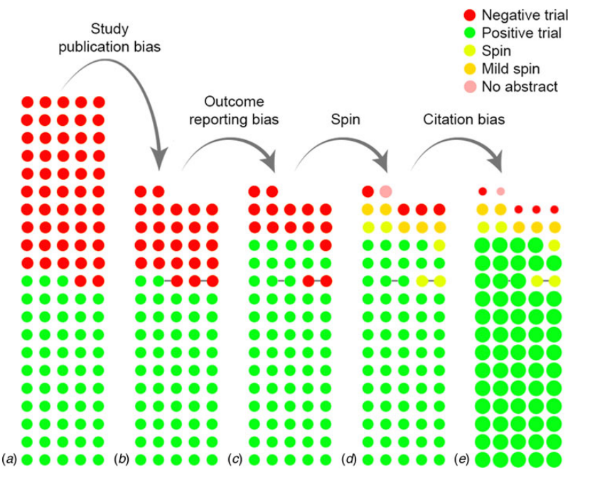
How negative results disappear
Notes:
de Vries YA, Roest AM, de Jonge P, Cuijpers P, Munafò MR, Bastiaansen JA. The cumulative effect of reporting and citation biases on the apparent efficacy of treatments: the case of depression. Psychological Medicine 2018: 1–3. https://doi.org/10.1017/S0033291718001873
” Ik denk dat we gewoon niet weten hoe generaliseerbaar de analyse is. Het zou geweldig zijn om deze analyse ook voor een aantal andere onderzoeksvragen te doen, zo mogelijk ook in verschillende (sub-) disciplines. Het probleem is wel dat de linker kolom (de gouden standaard die alle studies omvat die naar de betreffende onderzoeksvraag zijn gedaan in een bepaald tijdvak) alleen in uitzonderlijke gevallen beschikbaar is. Dat is het geval bij RCTs naar nieuwe geneesmiddelen die een handelslicensie willen verwerven en daarom 100% van de betreffende studies pre-registreren bij de FDA of EMA en daarbij ook het volledige onderzoeksprotocol aanleveren. Ik ken geen andere voorbeelden waar dit gebeurt, maar wellicht zijn die er wel.”
Kolom 1: rood=52; groen = 53 [omvang bijna nooit bekend, zie NEJM paper antidepressives]
Kolom 2: rood=25; groen = 52 [deze kolom is alleen zichtbaar bij 100% preregistratie van hoge kwaliteit]
Kolom 3: rood=15; groen = 62 [dit is wat kritische lezers/reviewers zien, die door spin kunnen heen kijken, maar geen zicht hebben op de geplande outcomes]
….Kolom 3b (not shown): the realitty for a critical reviewer who looks at the available preregistrations and is able to detect spin (at least partly)
Kolom 4: rood=4; groen = 62; geel=11 [dit is wat lezers/reviewers zien, die NIET door spin kunnen heen kijken]
Kolom 5: rood=4; groen = 62;geel=11 [maar let op de felheid en omvang van de bolletjes; nadruk door selectieve citatie]
De roze bol met No abstract begrijp ik niet; een negatieve trial waarvan het abstract wordt verwijderd?

Slide 3
How negative results disappear
True state of affairs
Preregistration,
spin detection,
complete search
No preregistration,
spin detection,
complete search
No preregistration,
no spin detection, complete search
No preregistration,
no spin detection, incomplete search
Notes:
de Vries YA, Roest AM, de Jonge P, Cuijpers P, Munafò MR, Bastiaansen JA. The cumulative effect of reporting and citation biases on the apparent efficacy of treatments: the case of depression. Psychological Medicine 2018: 1–3. https://doi.org/10.1017/S0033291718001873
” Ik denk dat we gewoon niet weten hoe generaliseerbaar de analyse is. Het zou geweldig zijn om deze analyse ook voor een aantal andere onderzoeksvragen te doen, zo mogelijk ook in verschillende (sub-) disciplines. Het probleem is wel dat de linker kolom (de gouden standaard die alle studies omvat die naar de betreffende onderzoeksvraag zijn gedaan in een bepaald tijdvak) alleen in uitzonderlijke gevallen beschikbaar is. Dat is het geval bij RCTs naar nieuwe geneesmiddelen die een handelslicensie willen verwerven en daarom 100% van de betreffende studies pre-registreren bij de FDA of EMA en daarbij ook het volledige onderzoeksprotocol aanleveren. Ik ken geen andere voorbeelden waar dit gebeurt, maar wellicht zijn die er wel.”
Kolom 1: rood=52; groen = 53 [omvang bijna nooit bekend, zie NEJM paper antidepressives]
Kolom 2: rood=25; groen = 52 [deze kolom is alleen zichtbaar bij 100% preregistratie van hoge kwaliteit]
Kolom 3: rood=15; groen = 62 [dit is wat kritische lezers/reviewers zien, die door spin kunnen heen kijken, maar geen zicht hebben op de geplande outcomes]
….Kolom 3b (not shown): the realitty for a critical reviewer who looks at the available preregistrations and is able to detect spin (at least partly)
Kolom 4: rood=4; groen = 62; geel=11 [dit is wat lezers/reviewers zien, die NIET door spin kunnen heen kijken]
Kolom 5: rood=4; groen = 62;geel=11 [maar let op de felheid en omvang van de bolletjes; nadruk door selectieve citatie]
De roze bol met No abstract begrijp ik niet; een negatieve trial waarvan het abstract wordt verwijderd?

Slide 4
How dangerous are systematic reviews?
Notes:
Statistical techniques can offer some correction for selective outcome reporting and "spin," but their effectiveness is limited and relies on several key assumptions. Here’s a more detailed look at these techniques and their underlying assumptions:
### Effectiveness of Statistical Techniques
#### Meta-Analysis Adjustments
- **Trim and Fill Method**: This technique aims to estimate the number of missing studies (due to publication bias) and adjust the overall effect size accordingly. It can correct some bias, but its accuracy diminishes if the assumptions about the missing studies are wrong.
- **Funnel Plots**: Used to visually inspect for publication bias. Asymmetry in the plot suggests bias, but this method is more of a diagnostic tool and not a corrective one.
- **Egger’s Test**: A statistical test to detect funnel plot asymmetry, indicating publication bias. While useful, it doesn't correct the bias itself.
#### Sensitivity Analysis
- **P-Hacking Adjustments**: Techniques like p-curve analysis and robustness checks can identify and adjust for the presence of p-hacking (selective reporting of p-values). These methods help gauge the extent of bias but may not fully correct it.
### Key Assumptions Underlying Statistical Techniques
#### Assumptions for Publication Bias Adjustments
1. **Missing at Random**: Many techniques assume that the missing studies (those not published) are randomly missing based on the effect size and other known factors. This assumption is often unrealistic, as studies are frequently missing for systematic reasons related to their findings.
2. **Distributional Assumptions**: Methods like the trim and fill rely on the assumption that the underlying distribution of study effects is known and that missing studies are symmetrically distributed around this central effect. If the true distribution is skewed, these methods may fail.
3. **Independence of Studies**: Meta-analytic techniques often assume that the included studies are independent of one another. However, if multiple studies come from the same research group or dataset, this assumption is violated, leading to biased results.
4. **Constant Bias Across Studies**: Some methods assume that the bias is constant across all studies. If the bias varies (e.g., larger biases in smaller studies), these techniques may not correct adequately.
#### Assumptions for Correcting Selective Outcome Reporting and Spin
1. **Known Number of Outcomes**: Techniques often assume that the researcher knows the number of potential outcomes and which ones might be selectively reported. In reality, this information is often unknown or incomplete.
2. **Proportional Reporting**: Some methods assume that the proportion of reported to non-reported outcomes is consistent across studies. This is often not the case, as selective reporting can be more prevalent in studies with certain characteristics.
3. **Objective Criteria for Outcome Selection**: Effective adjustment requires objective criteria to identify selectively reported outcomes. However, distinguishing between genuinely important results and selectively reported ones can be challenging.
4. **Availability of Raw Data**: Advanced methods for correcting selective reporting often rely on access to raw data to reanalyze and verify reported outcomes. This data is frequently unavailable, limiting the effectiveness of these corrections.
### Limitations and Complementary Approaches
Despite the availability of these statistical techniques, they have notable limitations. They often rely on assumptions that are difficult to verify and may not hold in practice. Therefore, these techniques should be complemented with:
- **Pre-Registration**: Registering study protocols and analysis plans in advance to prevent selective reporting.
- **Transparency and Open Data**: Encouraging researchers to share their data and analysis code to facilitate independent verification and meta-analyses.
- **Improved Peer Review**: Enhancing the rigor of the peer review process to detect and address potential biases and spin.
- **Education and Training**: Educating researchers about the risks of selective reporting and the importance of maintaining scientific integrity.
In conclusion, while statistical techniques can mitigate some effects of selective outcome reporting and publication bias, their effectiveness is limited by several key assumptions. A combination of methodological rigor, transparency, and ethical research practices is necessary to address these issues comprehensively.

Slide 5
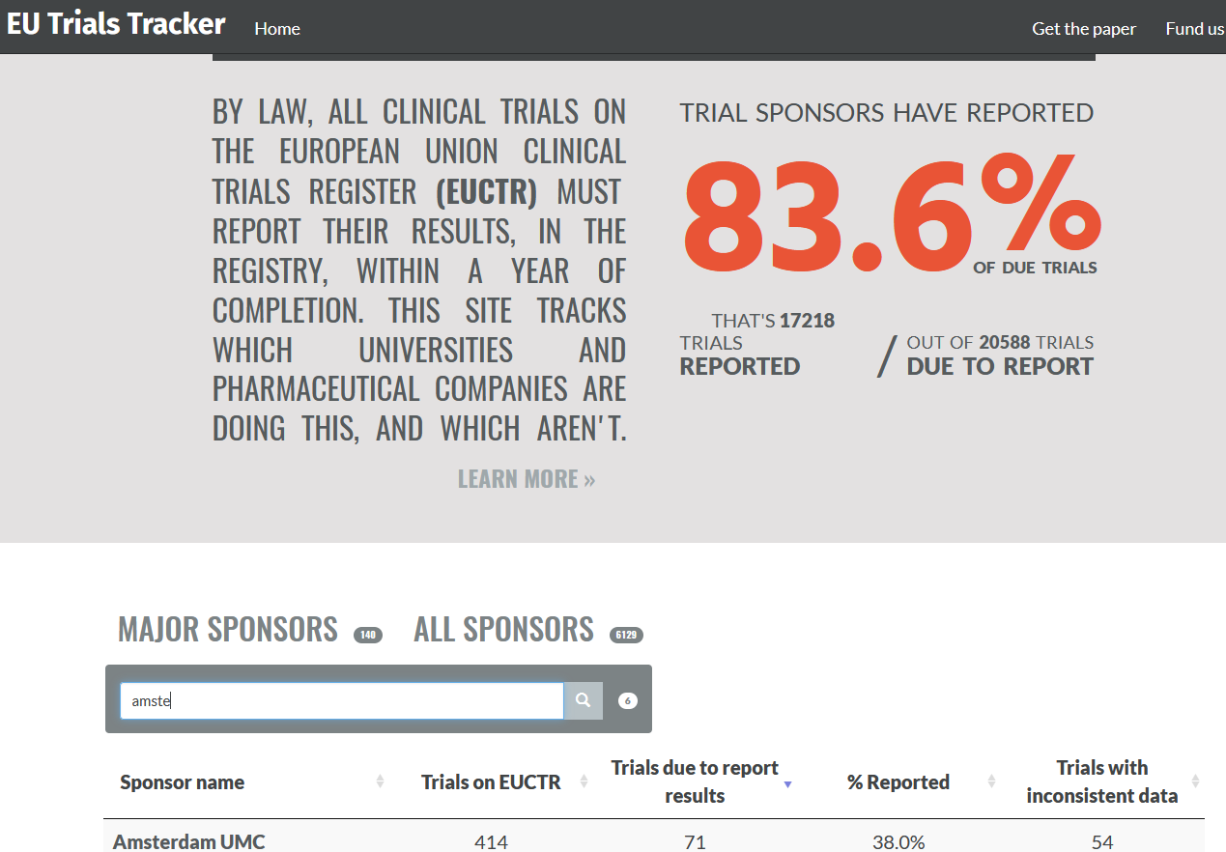
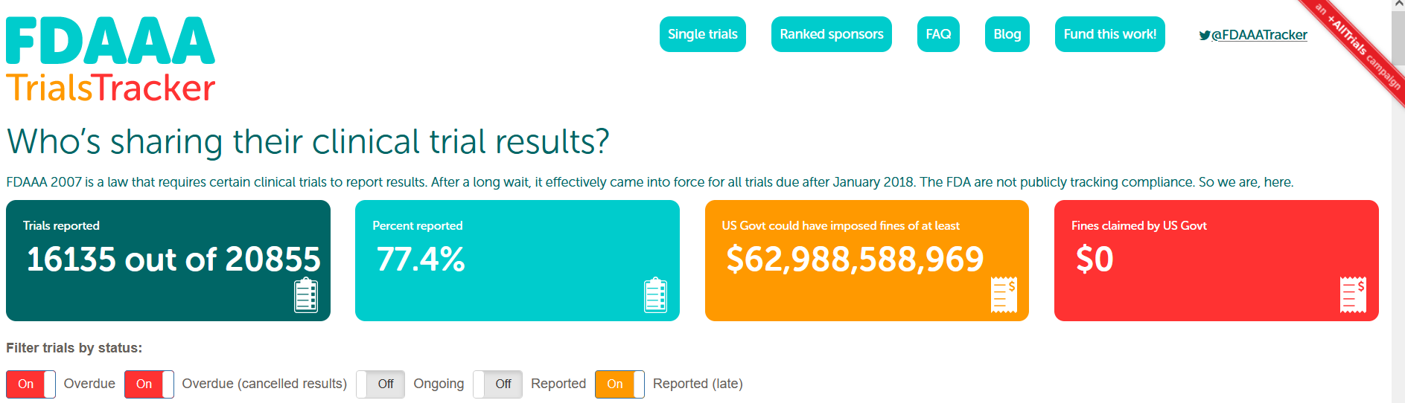
Proud to be a trialist in the AUMC?
Notes:
https://fdaaa.trialstracker.net/rankings/
https://eu.trialstracker.net/

Slide 6
Implications for systematic reviewers
Professional and up-to-date search specialist
Expert at four levels
Systematic review methods
Methods of primary studies
Subject matter of studies reviewed
Types of spin
Statistical adjustments for biased reporting (sensitivity analyses, multiverse)
Open science practices (sharing data and code, ..)

